Slide 1
Counterfeit Currency Detection for Automatic Dispenser Machines
Agha Syed Nasir Mahmood Azeemi
& Salman Muhammad Younus

Slide 2
Motivation
Rise in the use of Automatic dispenser machines (e.g. public transport ticket machines, food dispensers, car-park ticket machines, vending machines, arcade game machines etc.)
Increasing fraudulent activities. Circulation of $78 million in fake currency in US (2015).
Rise in the fake currency detector market.

Slide 3
Existing Methods
Database of digital fingerprints.
Illumination under black light.
Raised Texture Checking with 3D imaging.

Slide 4
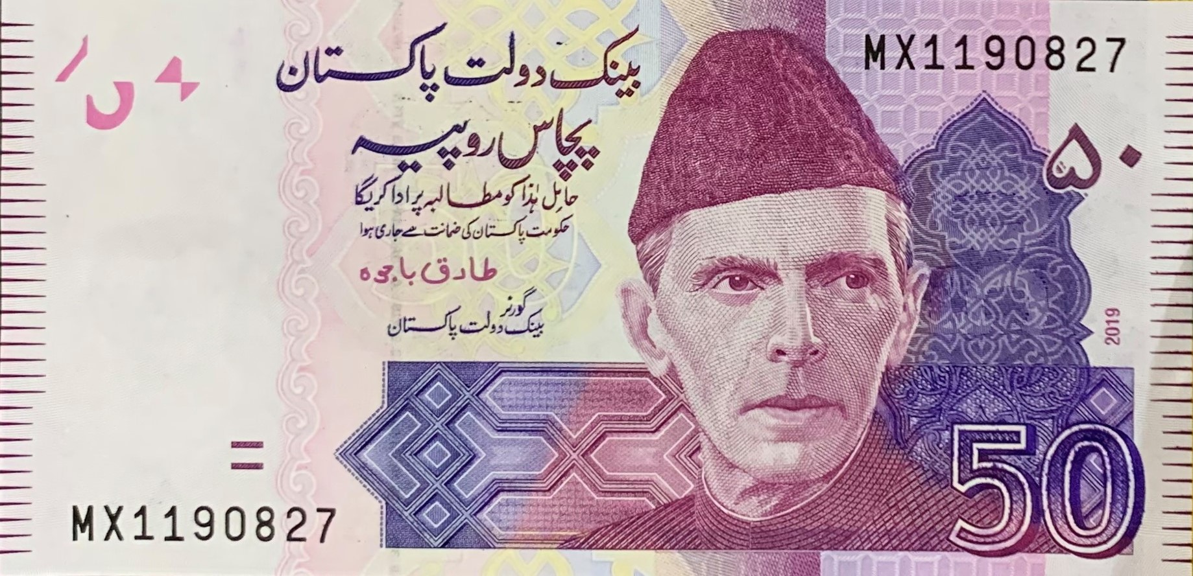
Our Methodology
Extract and Test 5 Security Features
4
3
5
1
2

Slide 5
Process Pipeline
Capture Image
Denomination
Segmentation & Checking
Front-lit
Back-lit
Determine Denomination
Segment Regions of Interest
Check for Counterfeiting

Slide 6
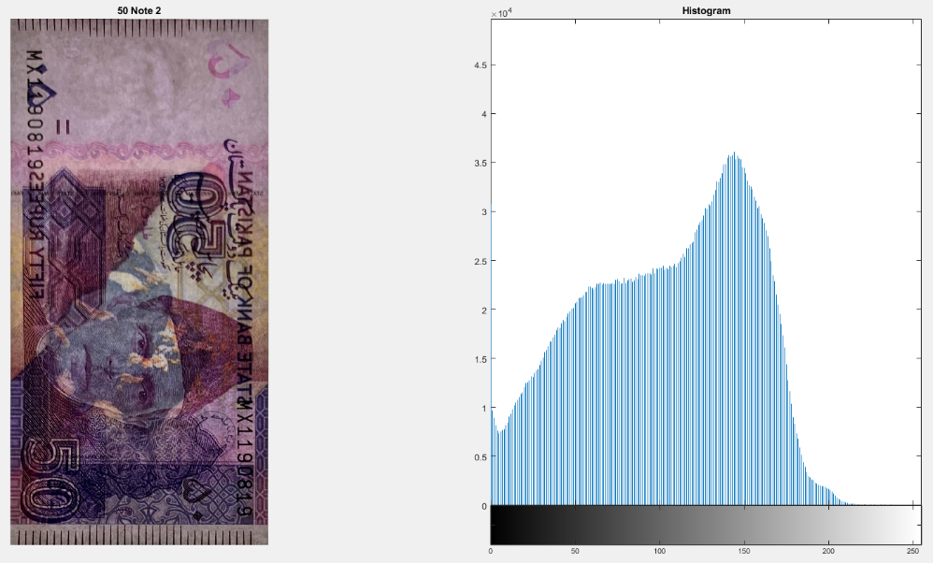
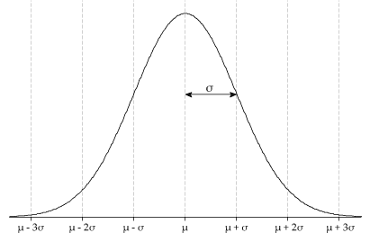
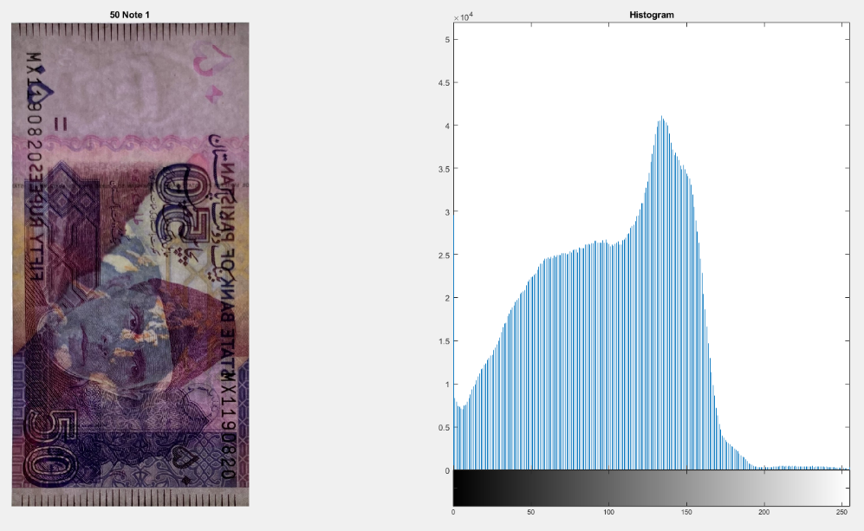
Denomination

Slide 7

1. Lines
Convert Image to Gray-Scale
Detect edges via Sobel Horizontal
Perform Morphological Processing and fill edges
Count Lines

Slide 8
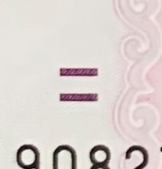

2. Denomination Markers
Repeat Process explained above
Count markers
Find area of markers via Region Properties

Slide 9


3. Signature
Convert Image to Gray-Scale
Detect edges via Canny
Perform Morphological Processing and fill edges
Use boundary and signature functions learned in lab

Slide 10
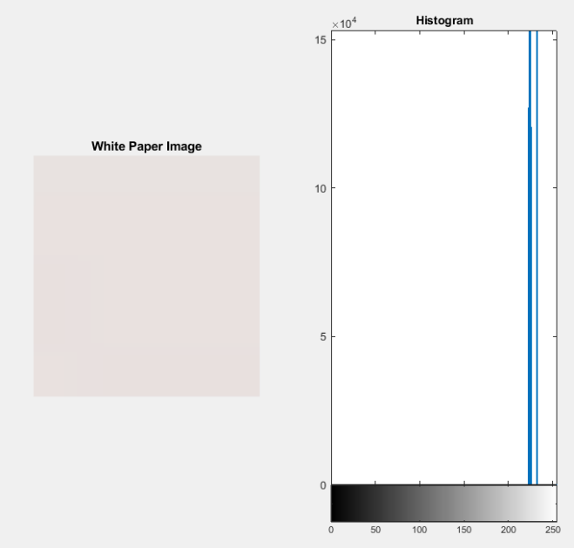
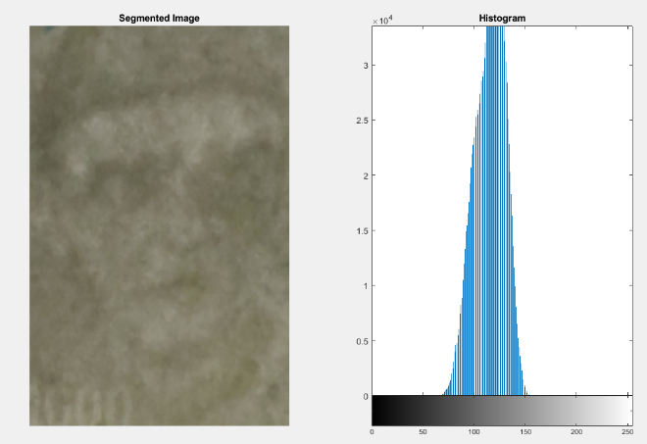
4. Watermark

Slide 11
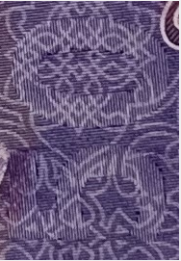
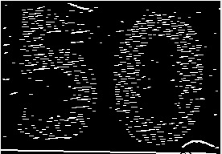

5. Latent Image
Convert to Gray-Scale
Find edges via Sobel Horizontal
Perform Morphological processing
Find area of shape via Region Properties

Slide 12
Thank You

